Slide 1
Computer Networks [Transmission Modes]

Slide 2
Transmission Modes
The way in which data is transmitted from one device to another device is known as transmission mode.
The transmission mode is also known as the communication mode.
Each communication channel has a direction associated with it, and transmission media provide the direction. Therefore, the transmission mode is also known as a directional mode.
The transmission mode is defined in the physical layer.
The Transmission mode is divided into three categories:
Simplex mode
Half-duplex mode
Full-duplex mode

Slide 3

Simplex Mode
In Simplex mode, the communication is unidirectional, i.e., the data flow in one direction.
A device can only send the data but cannot receive it or it can receive the data but cannot send the data.
This transmission mode is not very popular as mainly communications require the two-way exchange of data.

Slide 4


Simplex Mode
The radio station is a simplex channel as it transmits the signal to the listeners but never allows them to transmit back.
Keyboard and Monitor are the examples of the simplex mode as a keyboard can only accept the data from the user and monitor can only be used to display the data on the screen.

Slide 5
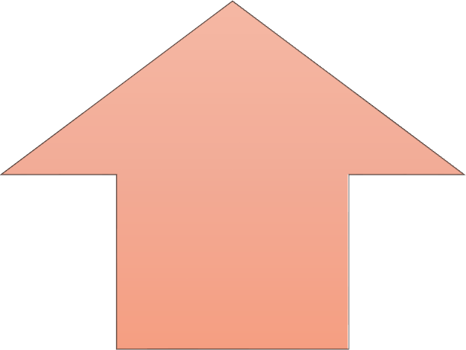
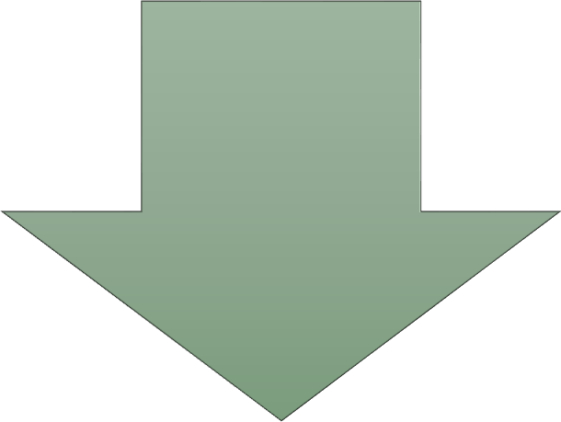
Advantage/Disadvantage of Simplex Mode
In simplex mode, the station can utilize the entire bandwidth of the communication channel, so that more data can be transmitted at a time.
Communication is unidirectional, so it has no inter-communication between devices.

Slide 6
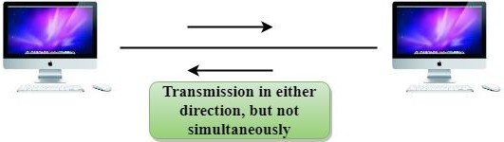
Half-Duplex Mode
In a Half-duplex channel, direction can be reversed, i.e., the station can transmit and receive the data as well.
Messages flow in both the directions, but not at the same time.
The entire bandwidth of the communication channel is utilized in one direction at a time.
In half-duplex mode, it is possible to perform the error detection, and if any error occurs, then the receiver requests the sender to retransmit the data.

Slide 7


Half-Duplex Mode
A Walkie-talkie is an example of the Half-duplex mode.
In Walkie-talkie, one party speaks, and another party listens. After a pause, the other speaks and first party listens.
Speaking simultaneously will create the distorted sound which cannot be understood.

Slide 8
Advantage/Disadvantage of Half-Duplex Mode
In half-duplex mode, both the devices can send and receive the data and also can utilize the entire bandwidth of the communication channel during the transmission of data.
In half-duplex mode, when one device is sending the data, then another has to wait, this causes the delay in sending the data at the right time.

Slide 9

Full-Duplex Mode
In full-duplex mode (also called duplex), both stations can transmit and receive simultaneously.
The full-duplex mode is like a two-way street with traffic flowing in both directions at the same time.
In full-duplex mode, signals going in one direction share the capacity of the link with signals going in the other direction. This sharing can occur in two ways:
Either the link must contain two physically separate transmission paths, one for sending and the other for receiving; or the capacity of the channel is divided between signals traveling in both directions.

Slide 10




Full-Duplex Mode
One common example of full-duplex communication is the
telephone network.
When two people are communicating by a telephone line, both can talk and listen at the same time.
The full-duplex mode is used when communication in both directions is required all the time.
The capacity of the channel, however, must be divided between the two directions.

Slide 11
Advantage/Disadvantage of Full-Duplex Mode
Both the stations can send and receive the data at the same time.
If there is no dedicated path exists between the devices, then the capacity of the communication channel is divided into two parts.

Slide 12
Differences
Basis for comparison | Simplex mode | Half-duplex mode | Full-duplex mode
Direction of communication | In simplex mode, the communication is unidirectional. | In half-duplex mode, the communication is bidirectional, but one at a time. | In full-duplex mode, the communication is bidirectional.
Send/Receive | A device can only send the data but cannot receive it or it can only receive the data but cannot send it. | Both the devices can send and receive the data, but one at a time. | Both the devices can send and receive the data simultaneously.
Performance | The performance of half- duplex mode is better than the simplex mode. | The performance of full-duplex mode is better than the half- duplex mode. | The Full-duplex mode has better performance among simplex and half-duplex mode as it doubles the utilization of the capacity of the communication channel.
Example | Examples of Simplex mode are radio, keyboard, and monitor. | Example of half-duplex is Walkie-Talkies. | Example of the Full-duplex mode is a telephone network.

